Slide 1
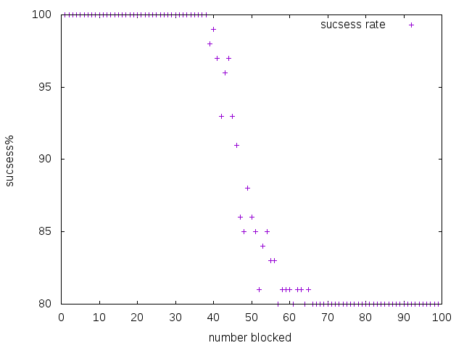
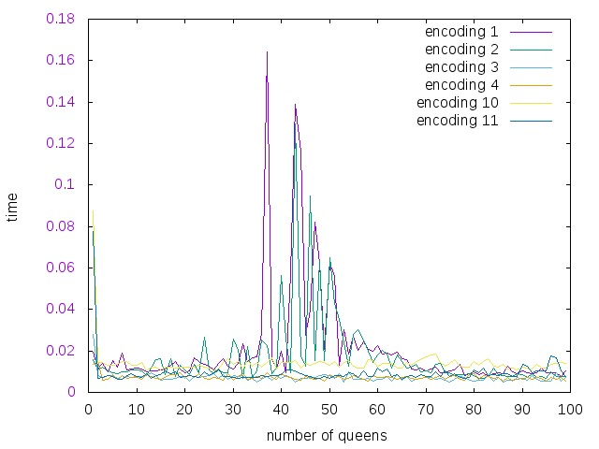
N-Queens Machine Learning
For these experiments we used a n*n chess board with some of the squares blocked. We noted that during the period where the problem becomes difficult to solve. This an be seen in the figure below. On the right you see percent satifiable to number of blocker, on the left time to solve vs number blocked.

Slide 2
Two of these encodings work well
The encoding queen4 works better in all cases besides the transition zone.
The encoding queen11 works better in the cases of the transition zone. Queen11 also gets better as n → \infty.

Slide 3
Machine Learning features
First we tried the following features to predict which encoding to use.
MaxQdiagonal,
MaxQcol
MaxQrow
blocked/n^2
n

Slide 4
Learning Results
Learning worked well when we considered features from over the set of all possible blocked sequences (knn 92%)that is because of the fact that we really do not have that many cases where n is a member of transition zone.
However when we considered only instainces from the transition zone our results were not as good.

Slide 5
Learning in the transition zone
LR: 0.765898 (0.050716)
LDA: 0.787996 (0.047097)
KNN: 0.753472 (0.037023)
CART: 0.721974 (0.055250)
NB: 0.714360 (0.032728)
SVM: 0.765898 (0.046181)

Slide 6
Learning in the transition zone
[[ 11 17],[ 15 117]] is the confusion matrix we get
TODO try this with harder data (note n=70 was used here) since the percentage of queen11 goes up as n→infty. This expirement will need to run for about a 4 days so I will run on euler.

Slide 7
Learning in the transition zone
precision recall f1-score support
queen11 0.42 0.39 0.41 28
queen4 0.87 0.89 0.88 132
avg / total 0.79 0.80 0.80 160

Slide 8
Now to try to do better
We shall now consider a set of sub problems. Namely we break the board into sub boards. And check the times for each encoding form it. We are using the features
Time4
Time11
%solutions
N
Then we predict correct winner.

Slide 9
First We tried something difforent
We tried to predict the the answer to a logic problem from subproblems.
We get some pretty amazing results.
We can predict the answer (SAT or UNSAT) with (KNN: 0.987992%) accuracy with NO information about how many blocked squares we have. Here is the confusion matrix
[[433 3],[ 8 56]]
We used 4 features

Slide 10
We are getting good results
Thus far we are getting good results on Machine predicting best encoding with the following features.
Time4suboard,time11suboard,solution?,n,blocked/n^2.
Using more data we get the same result.

Slide 11
Results with more data
I collected data from n=50,60,70. From all parts of the problem. A total of around 6000 instances and run with the following features.
Avg. time4 of subblocked square
Avg. time11 of subblocked square
N
% satisfiable of subsquares.

Slide 12
We can look at specifics
When looking at specific instances we can see the problem.
0.034330058,0.1011368111,0.2,50,queen4
0.0343410507,0.1011669581,0.2,50,queen11
These have the same features but the class is different.
We can predict all elements in the transition zone as queen11. But we really can’t do any better then that

Slide 13
Predicting SAT
However we can predict SAT or UNSAT way better. With knn the best 98%.
[[896 5],[ 17 182]]
Now this is really good thus we conclude Subboars are a good predictor of SAT or UNSAT but not what encoding is the best. Note there are 2 large transition zones in this data.
Also no information about how many blocked squares are given.

Slide 14
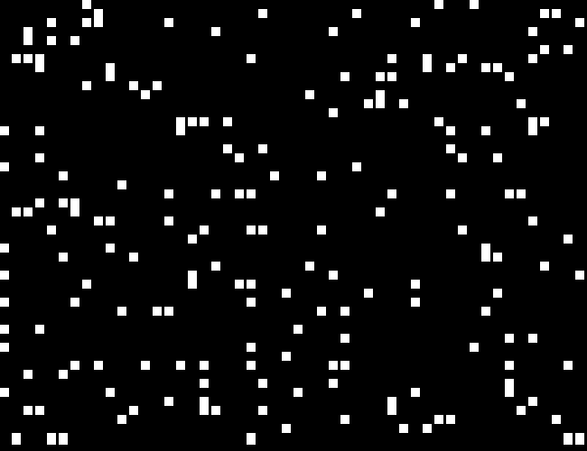
Image learning
I wrote a python script that takes as imput some blocked.lp file and out puts an image of blocked squares for example blocked2300.lp n=50 is

Slide 15
So I created a cnn
Note with just picking queen4 all the time we get > .8547 acurracy thus if we do better then that our modle has learned something.

